Slide 1
How to Build an Industry Cost Profile (ICP) for a product in Australia
Step 1
Identify Data Sources for Financial and Manufacturing Information Related to Industry Code
Step 2
Obtain the data for manufacturing and financial information related to industry
Step 3
Use Financial and Manufacturing Information to Calculate Ratios for COGS, PBT, GSA & Other

Slide 2
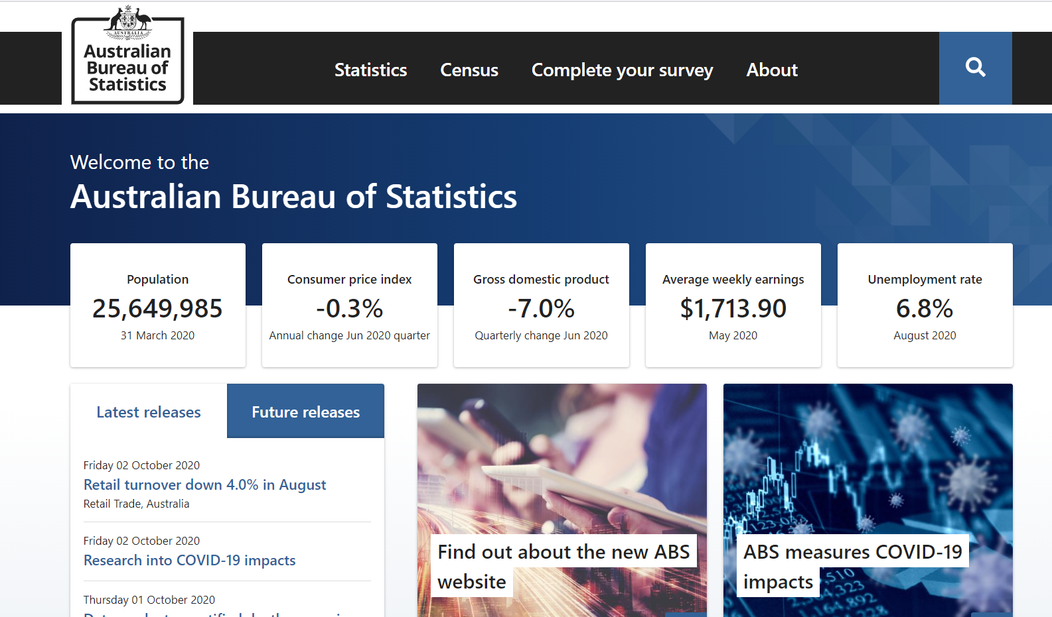
Identify Data Sources for Financial and Manufacturing Information Related to Industry Code
Step 1
Go to
2. On the top left, click on ‘Statistics
www.abs.gov.au

Slide 3
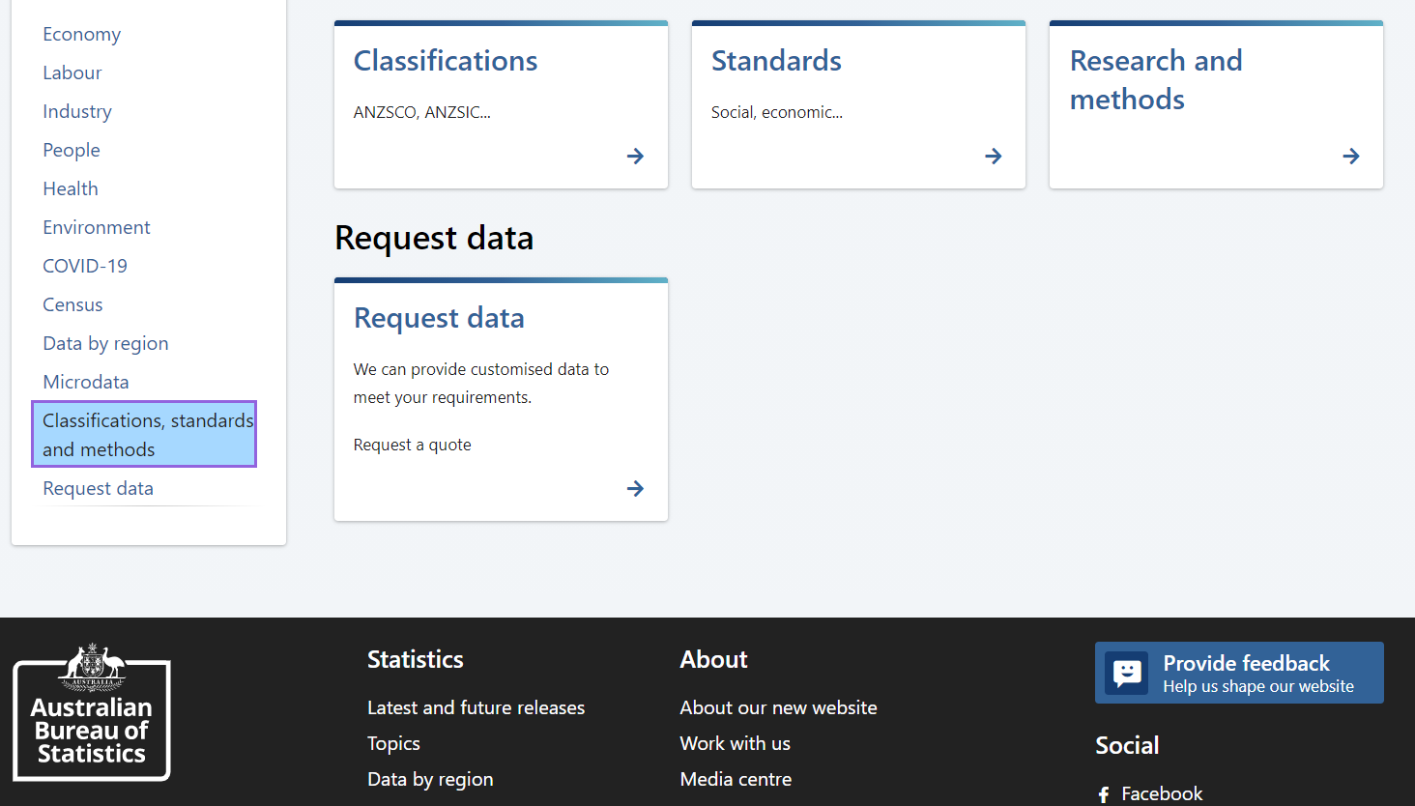
Identify Data Sources for Financial and Manufacturing Information Related to Industry Code
Step 1
2. Scroll down to Classifications, standards and methods, and Click on ‘Classifications’

Slide 4
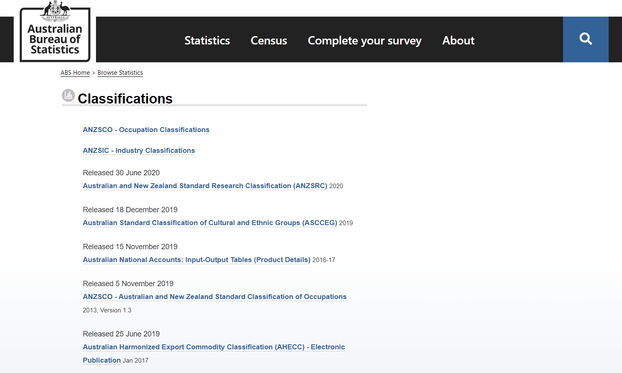
Identify Data Sources for Financial and Manufacturing Information Related to Industry Code
Step 1
3. Click on ‘ANZSIC – Industry Classifications’

Slide 5
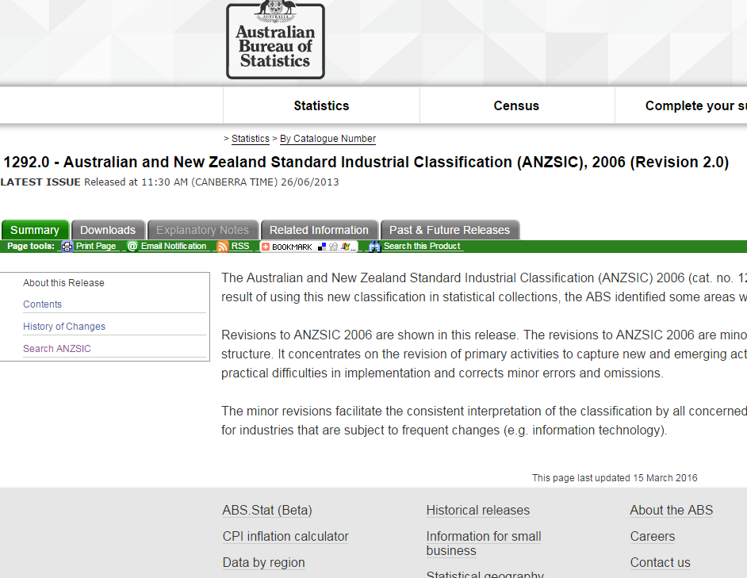
Identify Data Sources for Financial and Manufacturing Information Related to Industry Code
Step 1
4. Click on ‘Search ANSZIC’

Slide 6
Identify Data Sources for Financial and Manufacturing Information Related to Industry Code
Step 1
5. Search industry code description, e.g. ‘Pump Manufacturing’
6. Locate relevant ANZSIC code that matches the industry you are looking for

Slide 7
Obtain the data for manufacturing and financial information related to industry
Step 2
1. Go to
2. On the top left, click on ‘Statistics’
www.abs.gov.au

Slide 8
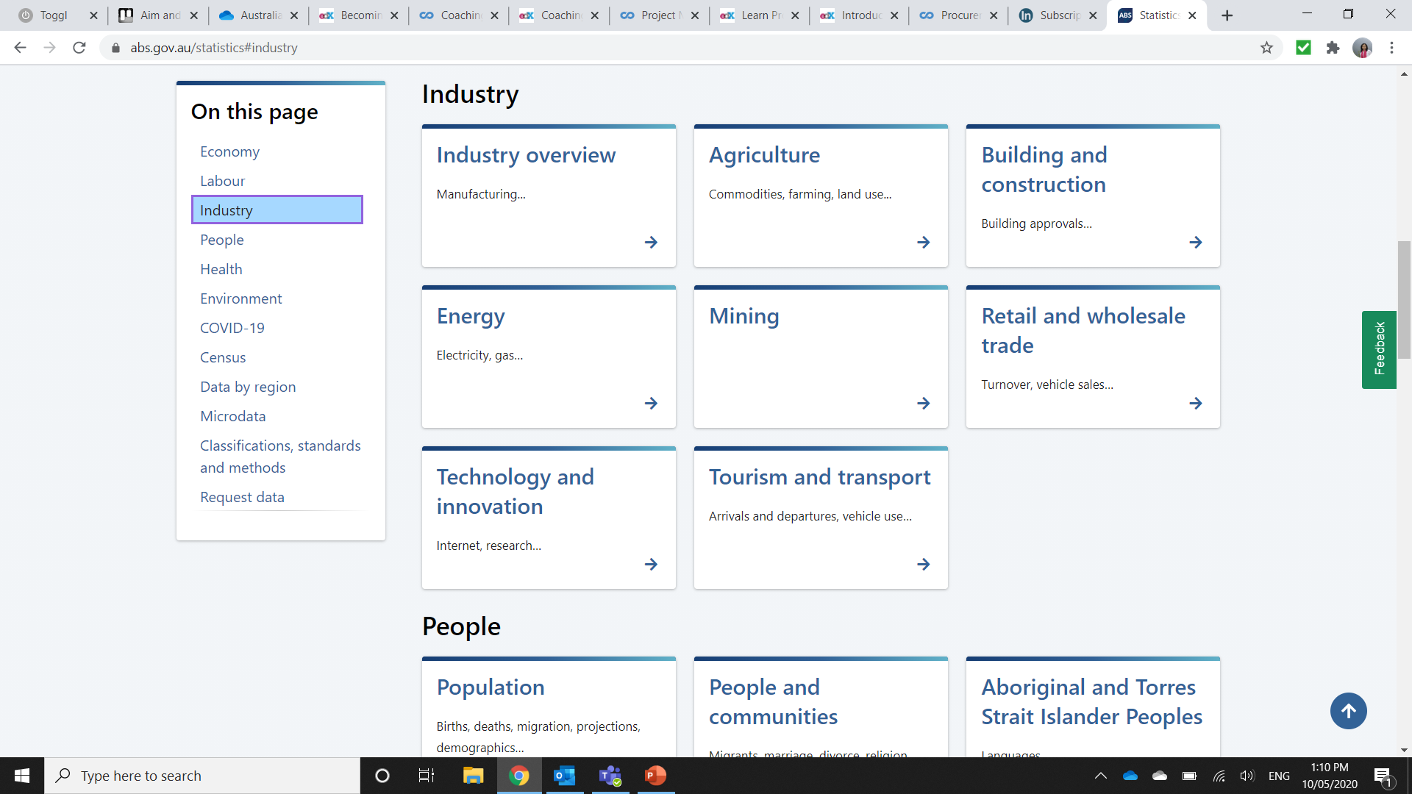
Obtain the data for manufacturing and financial information related to industry
Step 2
3. Scroll down to Industry, and Click on ‘Industry Overview’

Slide 9
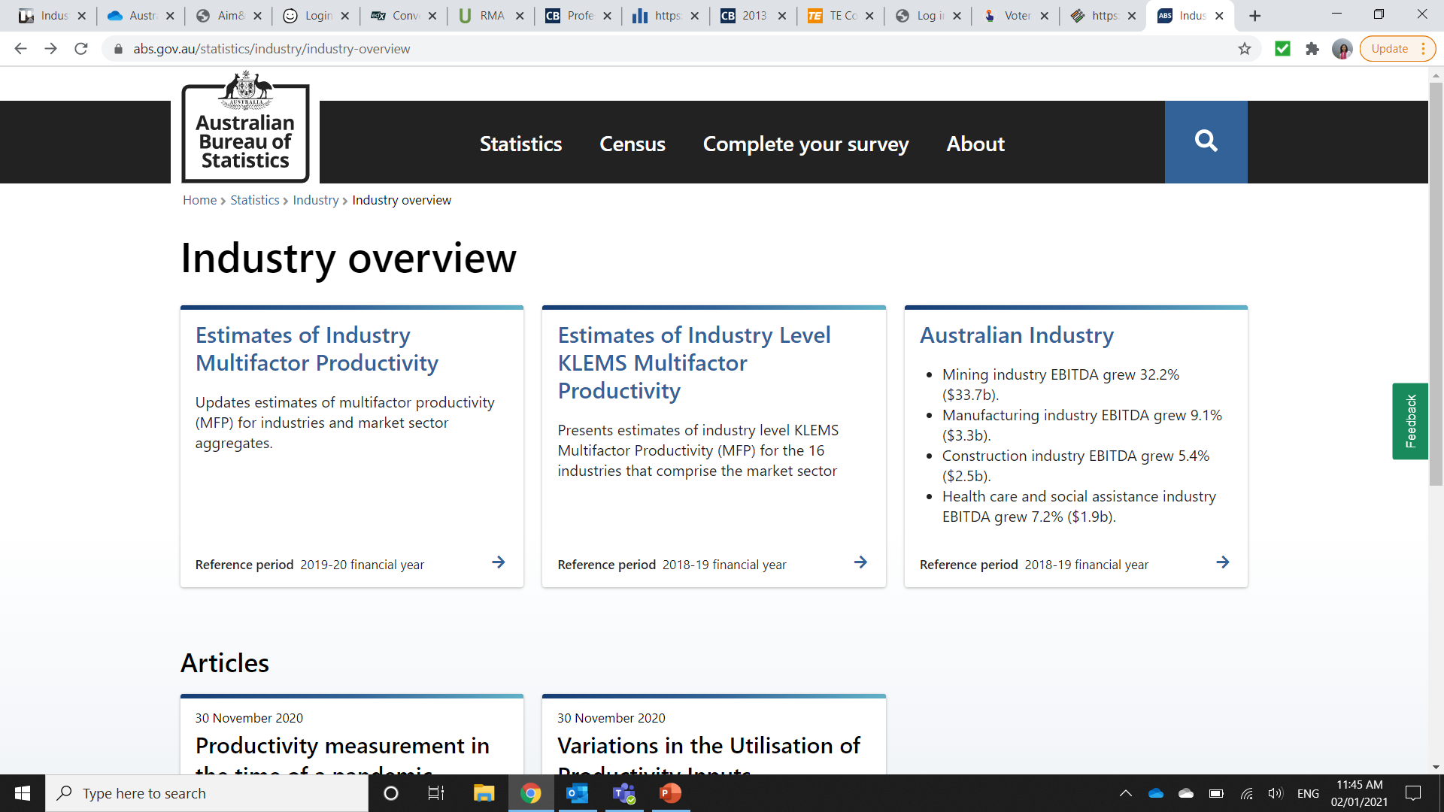
Obtain the data for manufacturing and financial information related to industry
Step 2
4. Click on ‘Australian Industry’

Slide 10
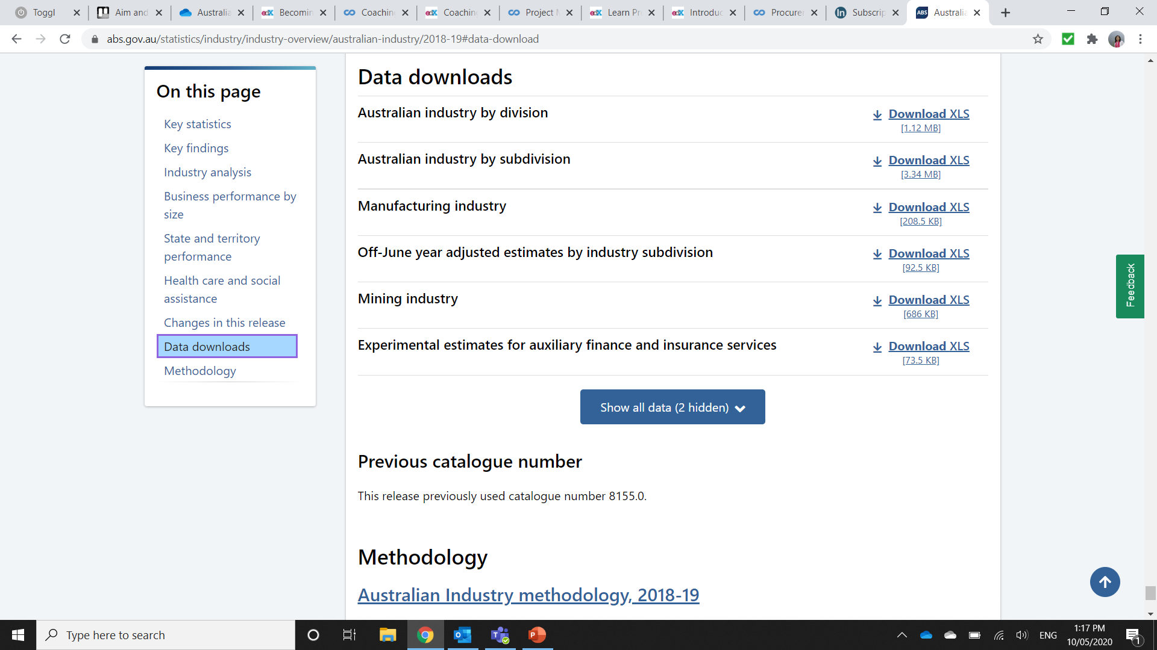
Obtain the data for manufacturing and financial information related to industry
Step 2
5. Scroll down to ‘Data Downloads’, Click on ‘Australian Industry by Subdivision’, and Click on the ‘.xls’ option to download the excel report.

Slide 11
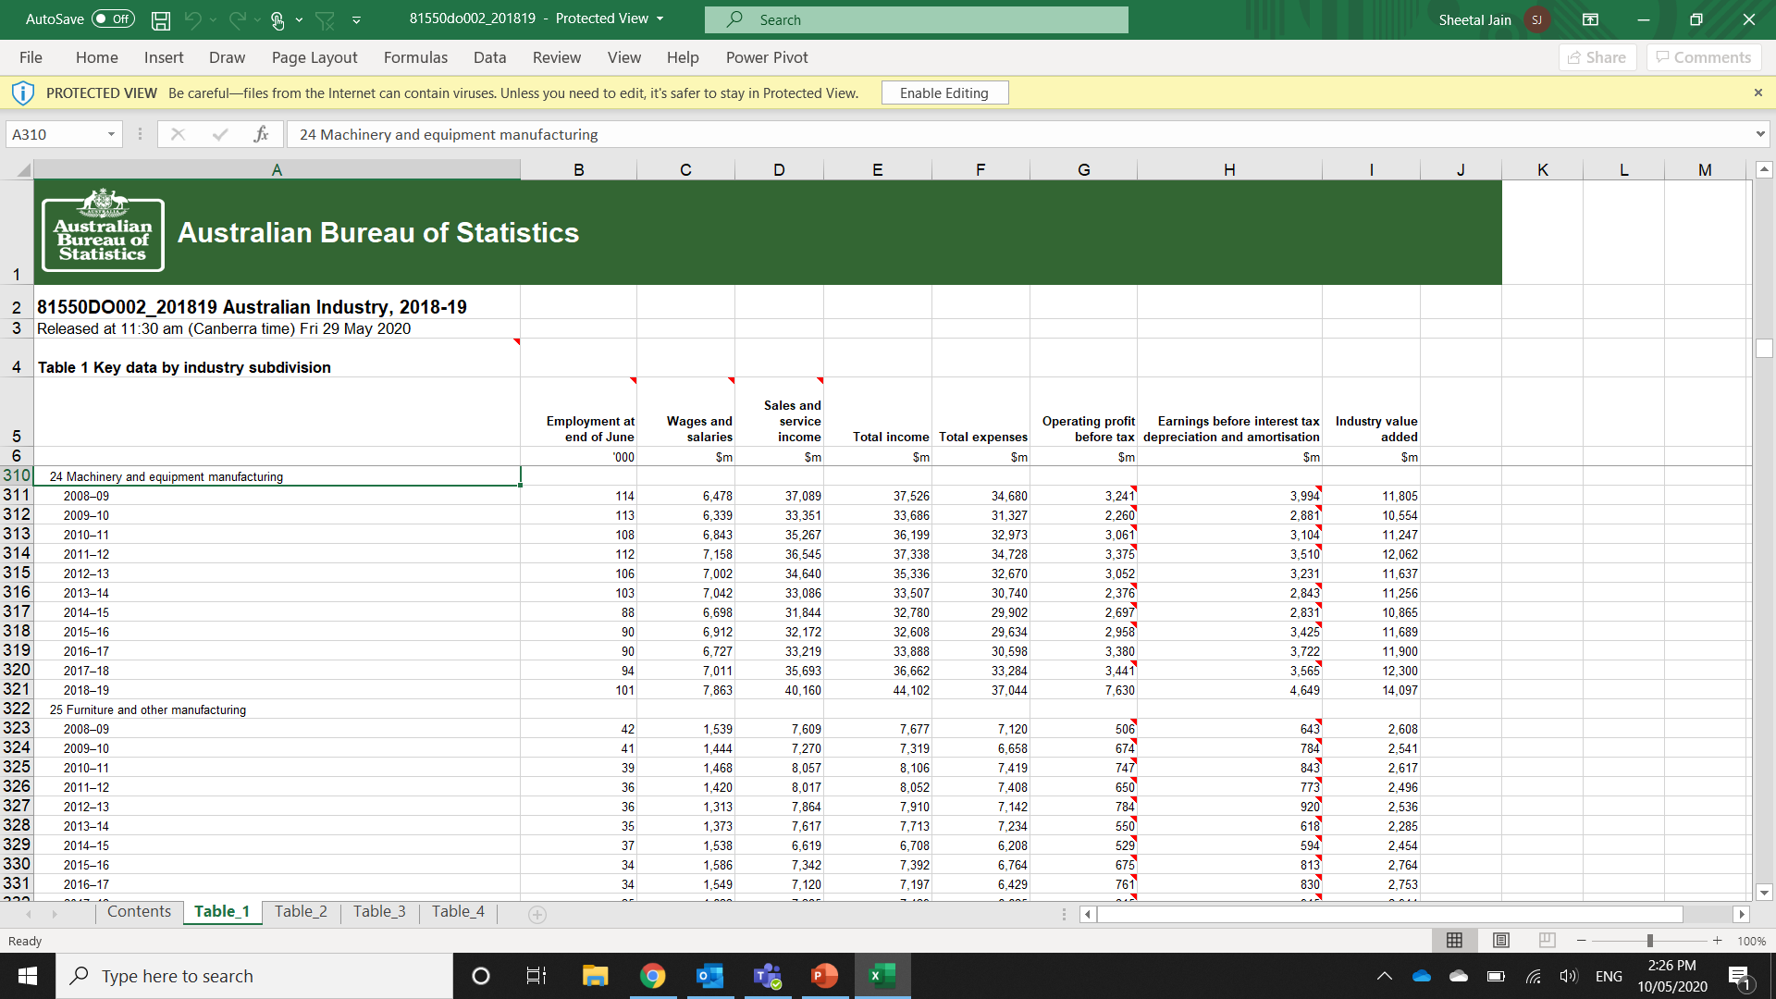
Obtain the data for manufacturing and financial information related to industry
Step 2
6. In worksheet “Table1” of the downloaded file, identify the industry of interest. These are the first 2 digits of the ANZSIC code.
7. Record the following variables for the year of interest:
Wages & Salaries (Total Labour Cost)
Sales and service income
Operating Profit Before Taxes

Slide 12
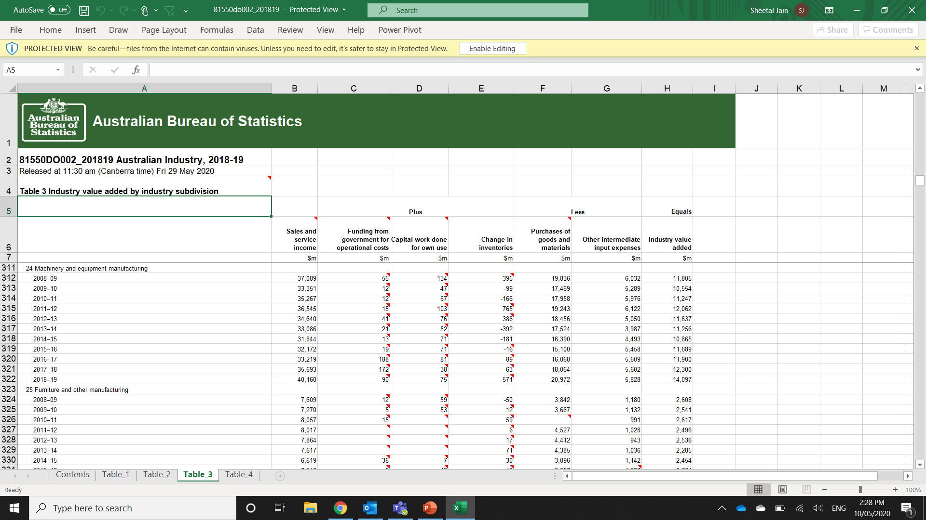
Obtain the data for manufacturing and financial information related to industry
Step 2
8. Then go to Table 3 to record the figures for the following variables for the year of interest:
Purchases of goods, materials
Other intermediate inputs expense

Slide 13
Obtain the data for manufacturing and financial information related to industry
Step 2
9. As a proxy, use the “US Bureau of Labor Statistics -Occupational Employment Statistics” to calculate the Direct Labour to Total Labour ratio – See the procedure
‘Direct-to-Total Labor Ratio using USA OES statistics’
We will use here the example “Other General Purpose Machinery Manufacturing – NAICS 333900” where the ratio is estimated to be 38%

Slide 14
Use Financial and Manufacturing Information to Calculate Ratios for COGS, PBT, GSA & Other
Step 3
10. Apply the Direct to Total Labour ratio to the Wages & Salaries (Total Labour Cost) previously obtained in Table 1, to obtain an estimate of Direct Labour cost
Then estimate the Indirect Labour component of Manufacturing Overhead based on the USA data. For NAICS 333900 this is estimated to be 25% of total labour cost.
 | Direct Labour (38% of Total Labour Cost) | =38% * 7,863
 | Direct Labour | 2,988
 | Indirect Labour Manufacturing Overhead (25% of Total Labour Cost) | = 25% * 7,863
 | Indirect Labour Manufacturing Overhead | 1,966

Slide 15
Use Financial and Manufacturing Information to Calculate Ratios for DM, DL, COGS, PBT, GSA & Other
Step 3
11. Use the following 6 steps to calculate DM, DL, MOH, COGS, PBT, GSA & Other Expenses:
Step 1:
Calculate the Direct Material (DM) ratio as percentage of Total Sales
Step 2:
Calculate the Direct Labour (DL) ratio as percentage of Total Sales.
 | Purchases of goods, materials | 20,972
 | Sales and service income (Total Sales) | 40,160
 | Direct Material (DM) | 52%
 | Direct Labour | 2,988
 | Sales and service income (Total Sales) | 40,160
 | Direct Labour (DL) | 7.5%
1.
2.

Slide 16
Use Financial and Manufacturing Information to Calculate Ratios for DM, DL, COGS, PBT, GSA & Other
Step 3
Step 3:
Calculate Manufacturing Overhead (MOH) by deduction as follows:
MOH = Other intermediate inputs expense + Indirect Labour Manufacturing Overhead
Calculate MOH ratio as a percentage of Total Sales
 | Other intermediate inputs expense | 5,828
 | Indirect Labour Mfg. Overhead | 1,966
 | Manufacturing Overhead (MOH) | 7,794
 | Manufacturing Overhead (MOH) | 7,794
 | Sales and service income (Total Sales) | 40,160
 | Manufacturing Overhead (MOH) | 19.4%
3.

Slide 17
Use Financial and Manufacturing Information to Calculate Ratios for DM, DL, COGS, PBT, GSA & Other
Step 3
Step 4:
Calculate Cost Of Goods Sold as follows:
COGS = DM+DL+MOH
Step 5:
Calculate Profit Before Taxes ratio as a percentage of Total Sales
Step 6:
Calculate GSA & Other Expenses as follows:
GSA & Other = 100-COGS-PBT
4.
Direct Material (DM) | 52.0%
Direct Labour (DL) | 7.5%
Manufacturing Overhead (MOH) | 19.4%
Cost of Goods Sold (COGS) | 78.9%
Operating Profit Before Taxes (PBT) | 7,630
Sales and service income (Total Sales) | 40,160
Profit Before Tax (PBT) | 19%
Total | 100%
Cost of Goods Sold (COGS) | 78.9%
Profit Before Tax (PBT) | 19%
GSA & Other Expenses | 2.1%
5.
6.

Slide 18
Present all your calculated ratios in the cost breakdown format
Industry Cost Profile for ‘2451 Centrifugal Pump Manufacturing’
 | Direct Material (DM) | 52.0%
 | Direct Labor (DL) | 7.5%
 | Manufacturing Overhead (MOH) | 19.4%
 | Cost of Goods Sold (COGS) | 78.9%
 | GSA & Other Expenses | 2.1%
 | Profit Before Tax (PBT) | 19.0%
 | Total Sales | 100.0%
Ratios calculated using data from the ‘”Australian Bureau of Statistics” and the “US Bureau of Labor Statistics”

